Slide 1
HIGH SEVERITY TRAFFIC CRASHES

Slide 2





THE TEAM
Ankitha
Akshitha
Rajsekhar
Alysia
Akash

Slide 3
Background/Motivation
Tempe is a city in Maricopa County, Arizona, United States, with the Census Bureau reporting a 2020 population of 180,587.While there are 55,000 accidents reported annually.
In United States, more than 5.8 million motor vehicle accidents occur every year. Of these, around 23 percent are weather related, which means, around 1.3 million accidents occur due to bad weather conditions.
While most of these accidents happen when the roadways are wet. In cities like California, where wet weather conditions cause accidents, Tempe, on the other hand, has dry weather conditions and is more prone to accidents.
Because of the high number of accidents in Tempe, it is critical that we understand the causes and factors that influence these accidents and find a solution.

Slide 4
Problem Statement
A road traffic accident is caused by a mix of factors relating to the system's components, which include roads, the environment, cars, and road users, as well as how they interact.
Some elements play a role in the incidence of a collision and so contribute to crash causation.
We cannot prevent accidents from occurring, but we may take precautions to avoid life-threatening injuries as a result of traffic accidents.
As a result, we're trying to figure out which factors play a role in causing accidents so that we may strive to reduce them.

Slide 5
Project Proposal
Our Project team will create an analytical framework that can be used to identify the risk factors involved in road traffic injuries and decrease the number of accidents happening.
We will also analyse at which location does most of the accidents occur and how we can prevent them

Slide 6
Analysis Questions
What is the major cause of accident on a dry road ?
Which driving actions and road violations influence the road accidents ?
At which locations did most of the accidents occur ?
What are the time frames when most of the accidents happen?

Slide 7

Dataset Description
Name : High Severity Traffic Crashes (Performance Measure 1.08)
The dataset consists of 33 columns and 28839 rows in table.
This dataset is used in Traffic Engineering and Transportation to improve safety in Tempe.

Slide 8
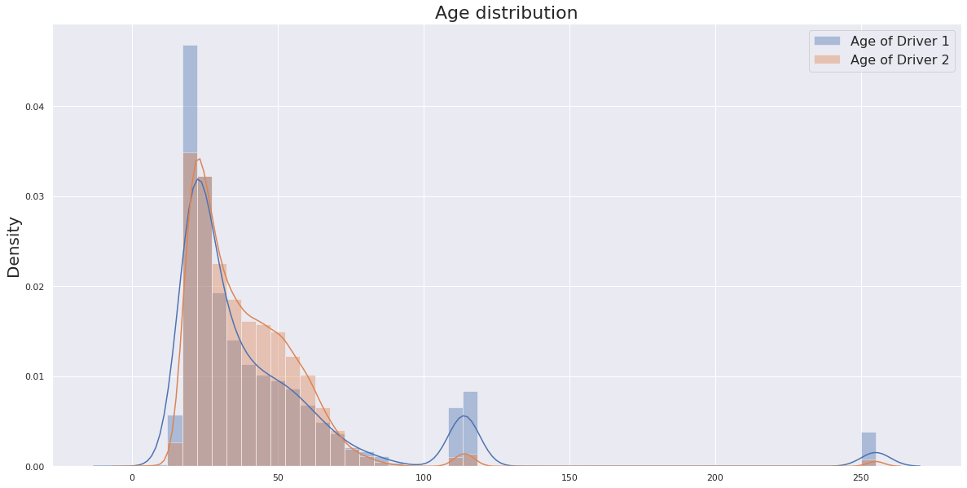
Age Distribution
Here we can observe that most of the accidents occur between the age group 17 to 85
Outliers

Slide 9
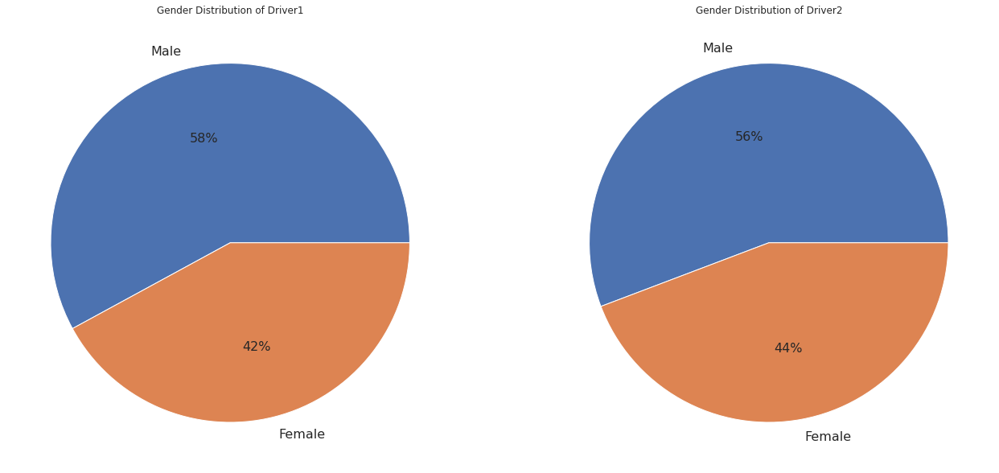
Gender Distribution

Slide 10
Data Cleaning

Slide 11
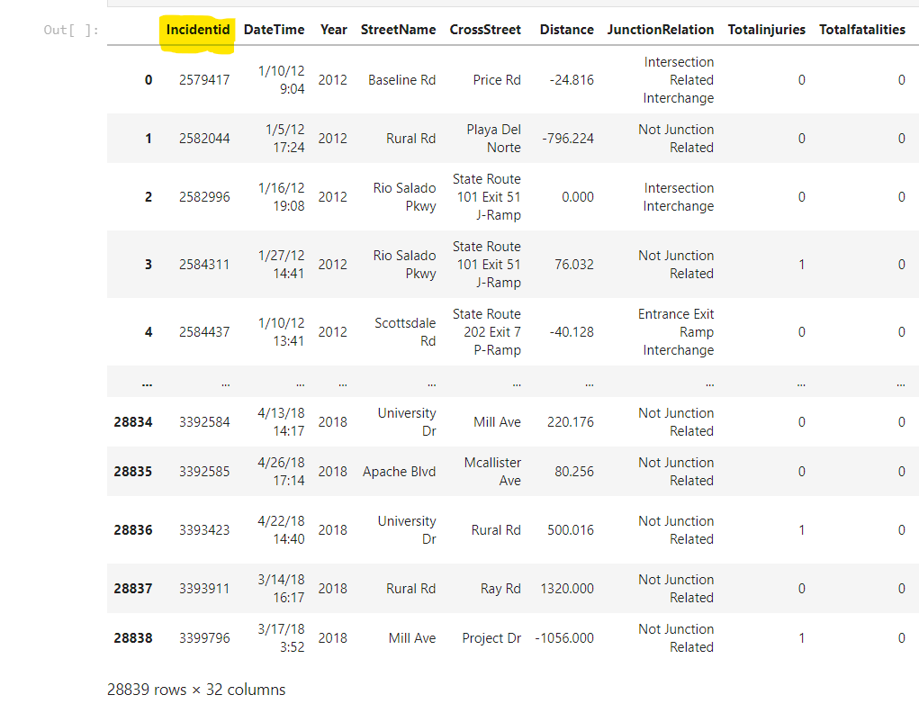
Data Cleaning
Incident id has been removed because they comprise of unique values that is not helpful for the analysis.

Slide 12
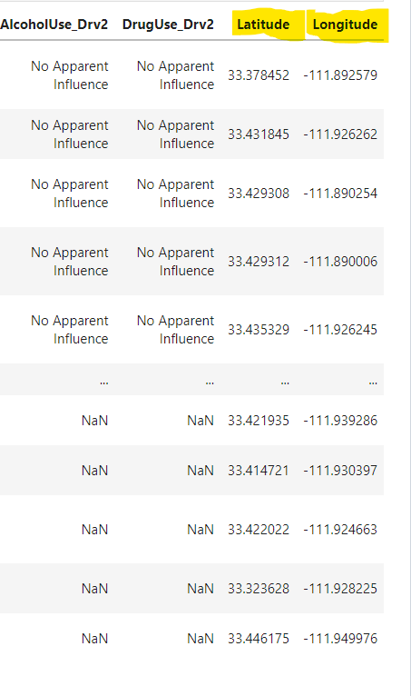
Data Cleaning
Longitude and latitude columns are removed because the values are clustered together and its difficult to interpret a map from it.

Slide 13
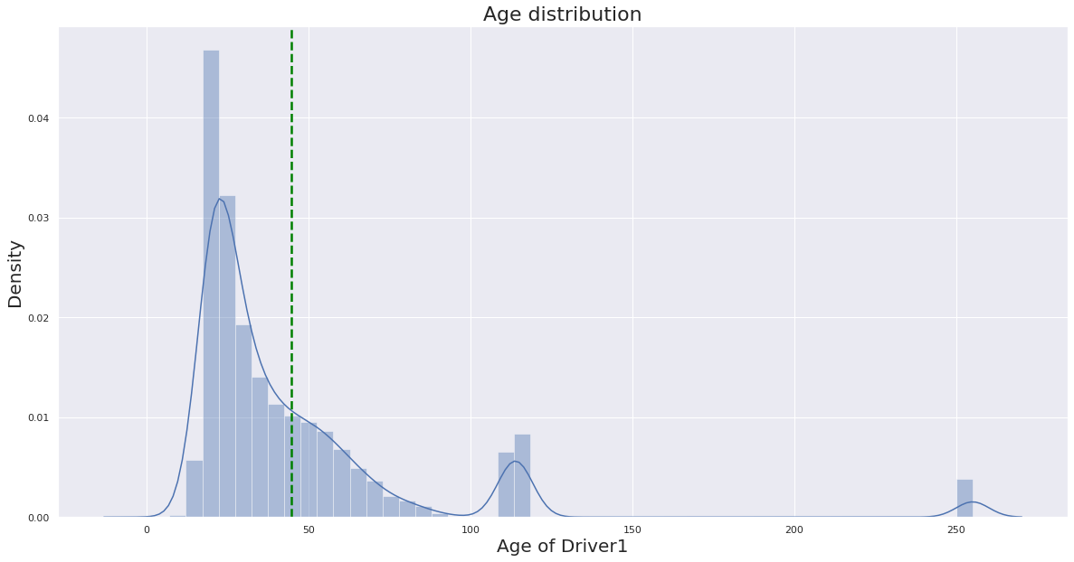
Data Cleaning
The data set that comprised of outliers has been cleaned and removed.
Outliers

Slide 14
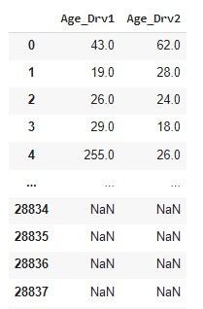
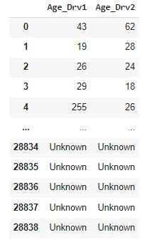
Data Cleaning
Replaced “NaN” with “unknown” to deal with the missing value.

Slide 15
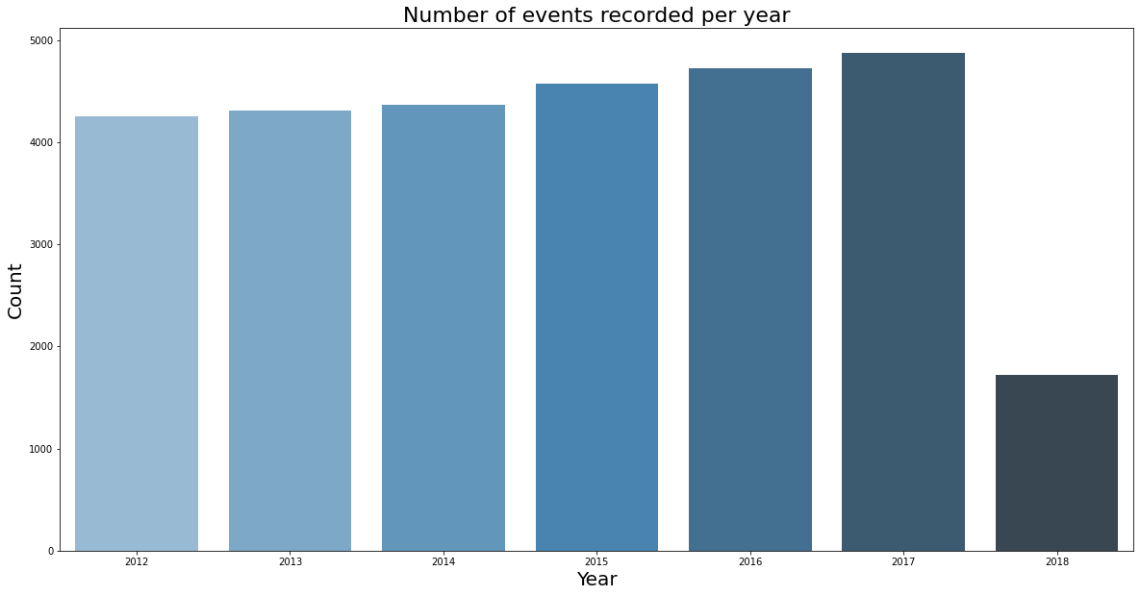
Data Cleaning
Removed insufficient observations of year 2018.

Slide 16
Data Transformation

Slide 17
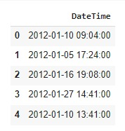
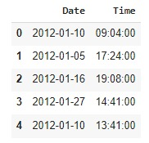
Data Transformation – Split DateTime Column
Since the date and time column is merged, we’re splitting the date and time column for a better understanding on when the accident happens the most.

Slide 18
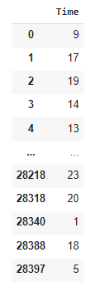
Data Transformation – Hours and Minutes to Hours
To look at the bigger time frame here we are disregarding minutes

Slide 19
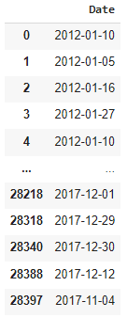
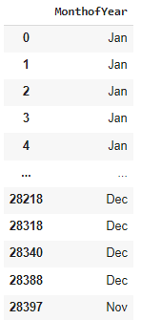
Data Transformation – Derive new column for months
Derived new column “MonthofYear”

Slide 20
Data Analysis

Slide 21
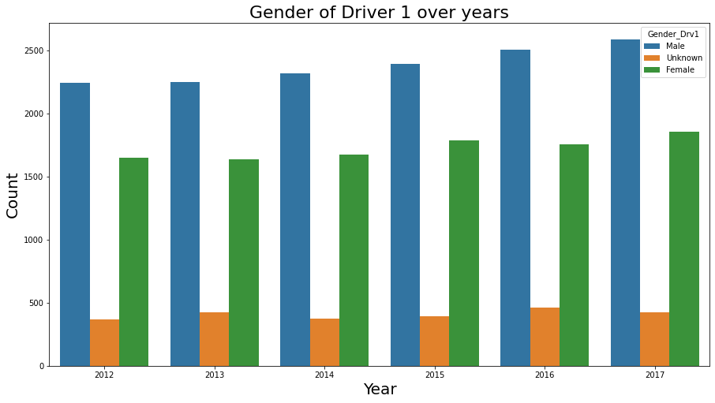
Analysis - Gender
Here we can see that males tend to get into more accidents than females.

Slide 22
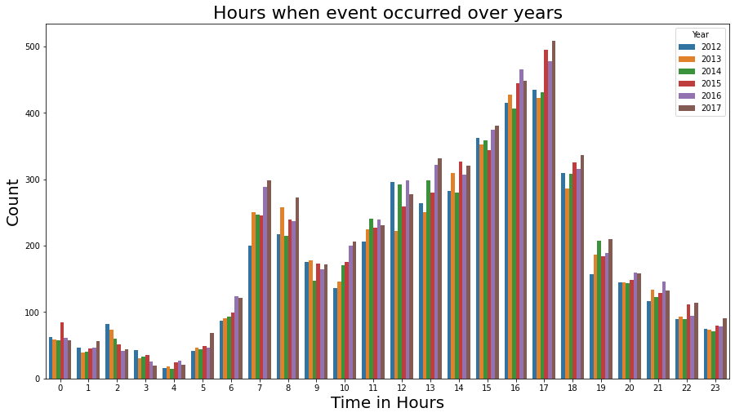
Analysis – Time Frames
It can be observed that most of the accidents are happening during late noon and early evenings between 14:00 to 18:00 hours.

Slide 23
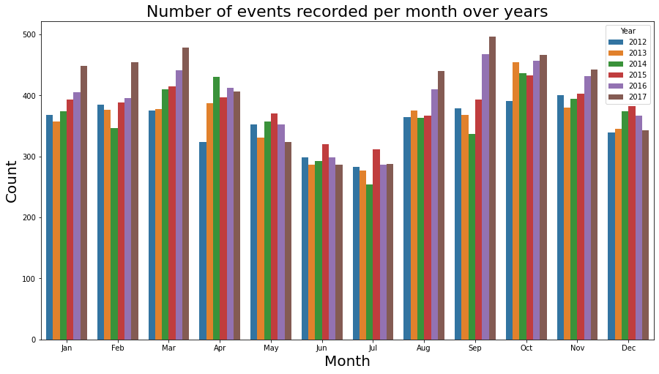
Analysis – Events
It can be observed that most of the accidents occurred in the month of September, whereas the month of July recorded the least number of accidents.

Slide 24
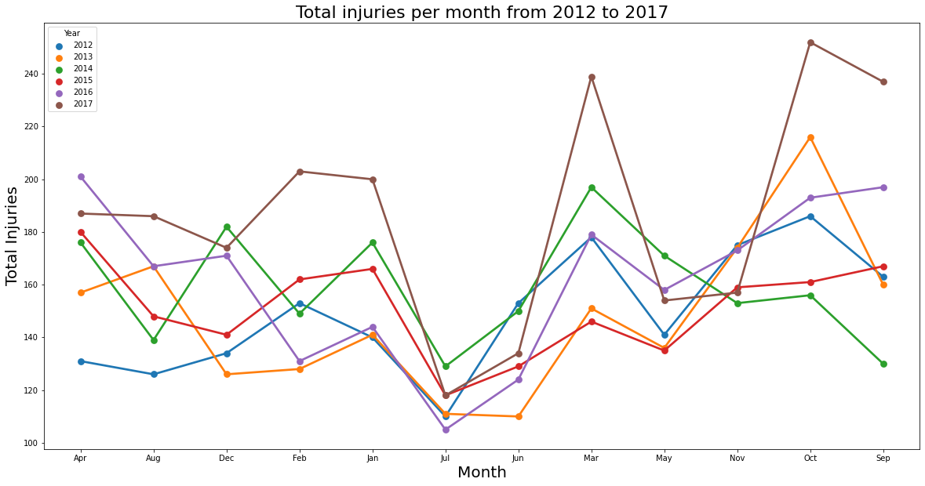
Analysis - Injuries
It is observed that number of injuries somewhat follows the pattern of number of crashes.

Slide 25
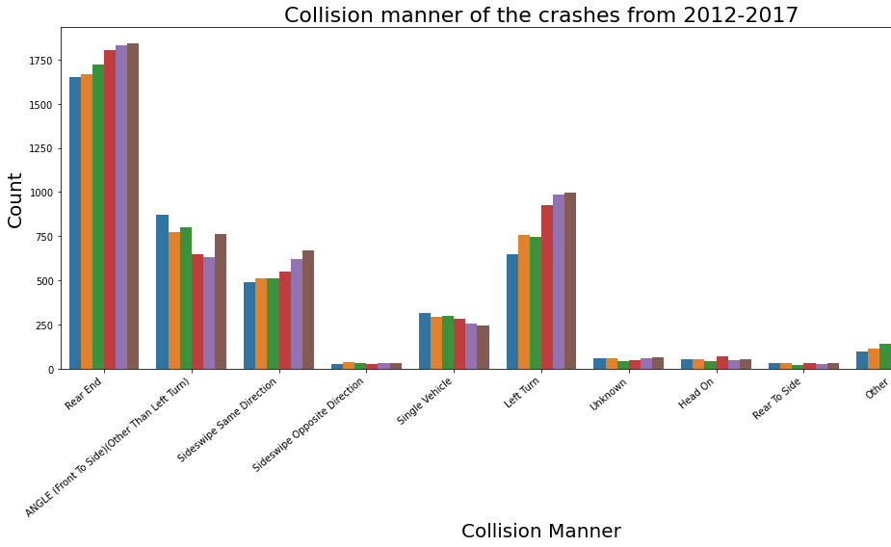
Analysis – Collision Manner
Here we can see that most of the collisions in the accidents were on the rear end.

Slide 26
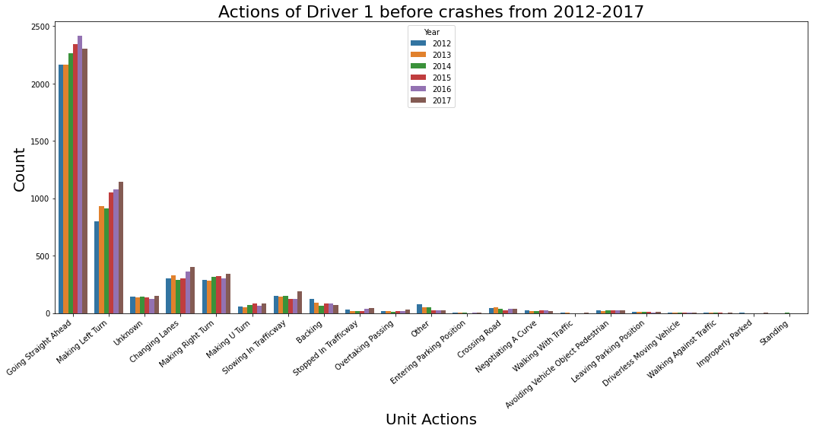
Analysis – Actions
Highest number of accidents happened while going straight.
It is interesting to note that ‘Making Left Turn’ was the second highest accident causing action for Driver 1.

Slide 27
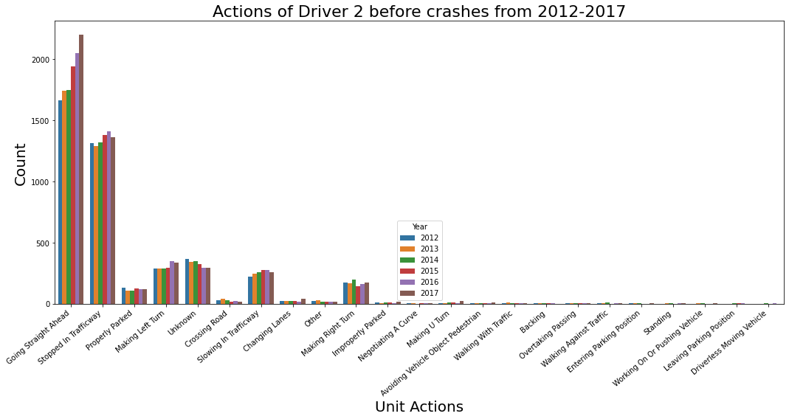
Analysis – Actions
Highest number of accidents happened while going straight.
It is interesting to note that ‘Stopped in Traffic way’ was the second highest accident causing action for Driver 2.
Hence from the previous and current slide it is seen that most accidents happened while one of the vehicle was stationery.

Slide 28
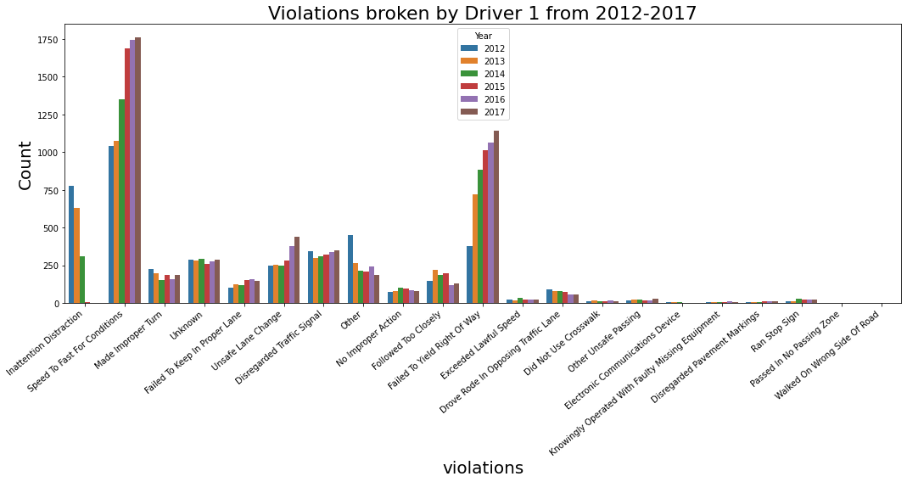
Analysis – Violations
Highest number of violations broken was speedy driving.
It is interesting to note that ‘Failed to yield Right of Way’ was the second highest accident causing violation for Driver 1 and it is steadily increasing over the years.

Slide 29
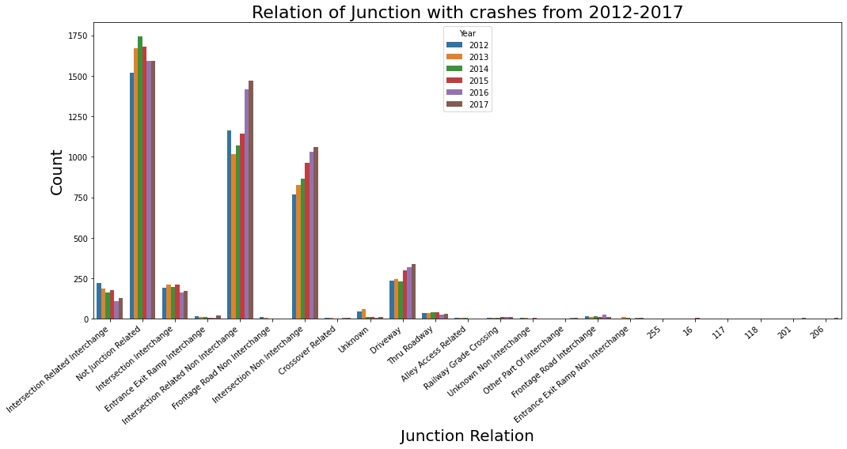
Analysis – Junctions
It can be seen from the graph that most of accidents happened were somewhat related to intersection and driveway.
It is also interesting to note that most accidents were not related to junctions.

Slide 30
Conclusion
Following a thorough examination of the traffic-crash data. We can observe the patterns and connections between the crashes, their locations, and the frequency with which they occur.
Vehicles going straight ahead are one of the most common causes of crashes on the main road, and the most common violations are speeding and failing to yield right of way.
It can be noted that most of the collisions in the accidents were on the rear end.

Slide 31
Conclusion
We can also see that the highest number of accident-causing actions for both Driver 1 and Driver 2 occurs while driving straight. While making a left turn is the second most accident-causing action for Driver 1, stopping in the traffic lane is the second most accident-causing action for Driver 2.

Slide 32
Conclusion
It can be concluded that most of the collisions occurred at intersections and driveways; however, it is worth noting that the majority of the collisions were not caused by junctions.
This analysis can assist the Arizona Traffic Department in acting appropriately and attempting to reduce the number of traffic accidents that occur on that particular road or street.

Slide 33
Recommendations
Implement precise activities such as defining and enforcing speed limits, allocating traffic lights and sign boards, and driving in prescribed roadways to prevent road traffic crashes, reduce injuries and their consequences, and analyze the impact of these actions.

Slide 34
Recommendations
The traffic department should also take action against persons who ignore traffic signals, such as levying fines and suspending licenses.

Slide 35
Data Product - Tableau

Slide 36
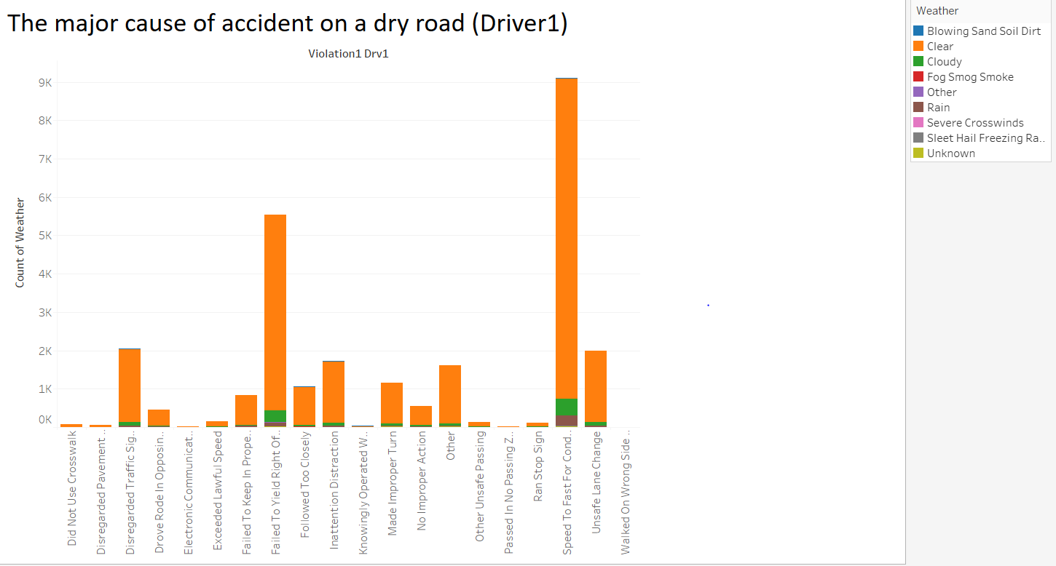
Cause of accident for driver 1
Most of the accidents took place on a clear day.
The major cause of accidents for driver 1 was because of ‘over speeding’ followed by ‘Failed to yield right of way’

Slide 37
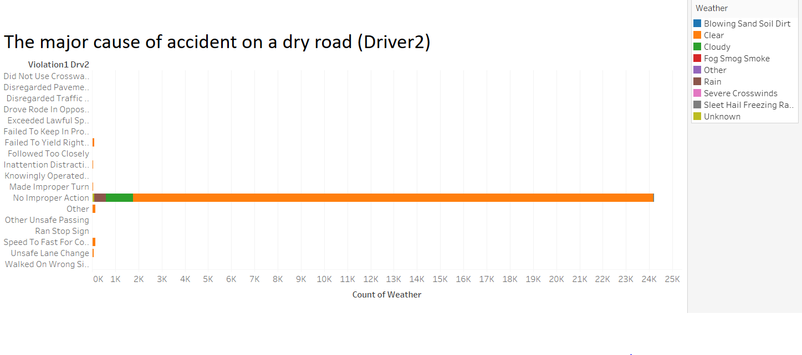
Cause of accident for driver 2
From this data is it evident that only one of the drivers is involved in most of the crashes (No improper action).

Slide 38
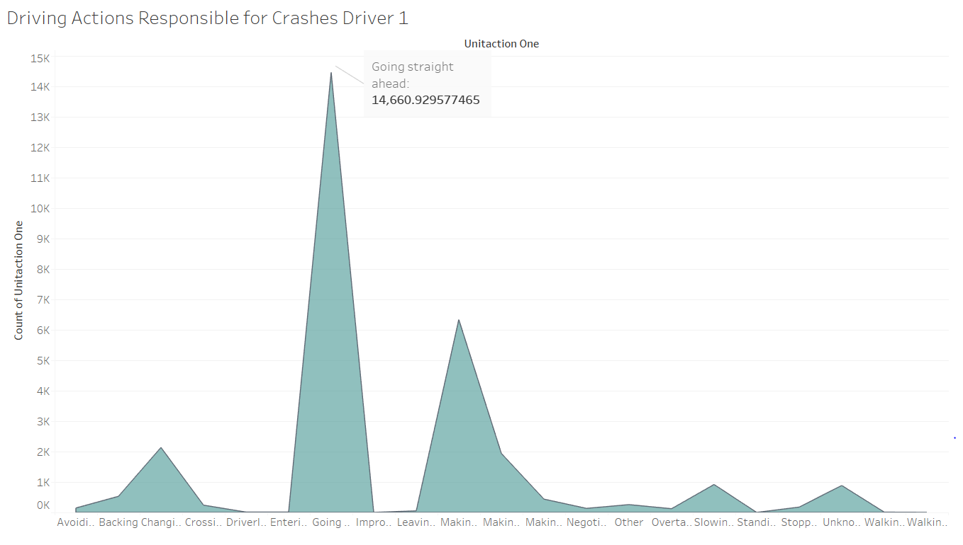
Actions responsible for crashes - Driver 1
Most of the accidents for driver 1 happen when they were going ‘straight ahead’
The second being when they were making a ‘left turn’

Slide 39
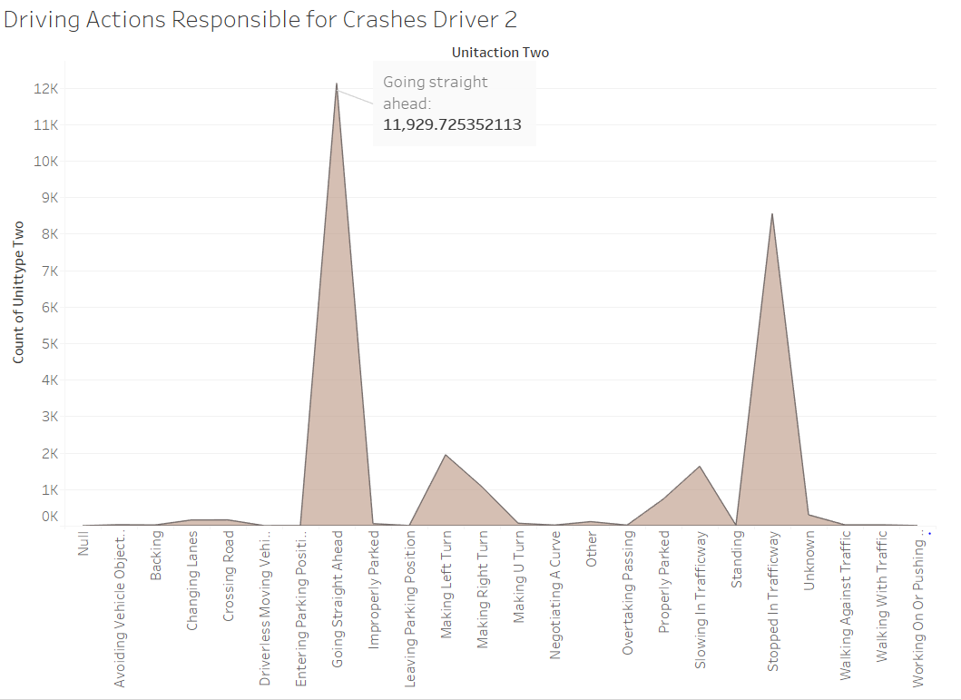
Actions responsible for crashes - Driver 2
Most of the crashes happen when the driver 2 was going ‘straight ahead’
Different from driver 1, the second most crashes happen when driver 2 had ‘stopped in the trafficway’

Slide 40
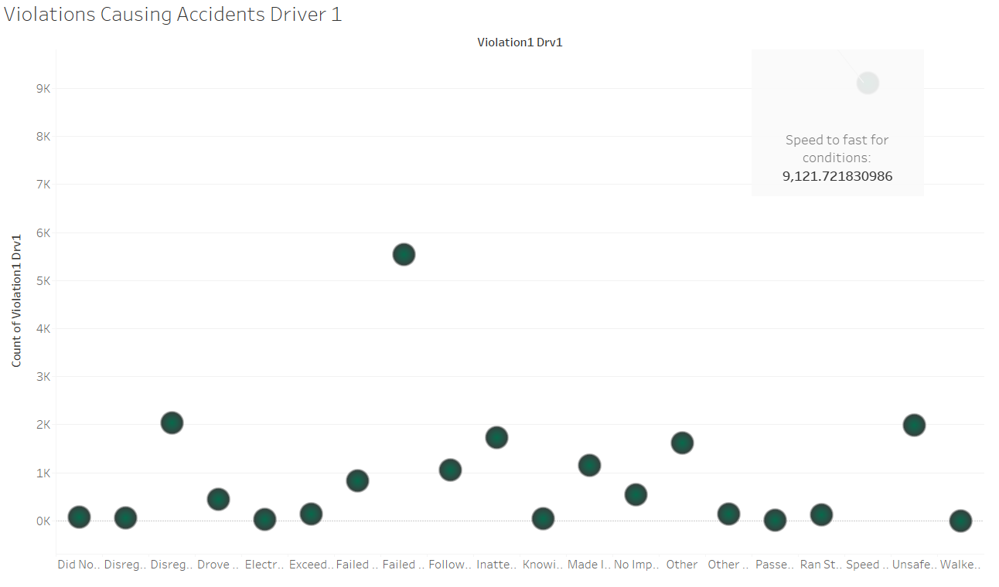
Violations that caused accidents - driver 1
‘Speeding’ was the violation that most of the driver 1 caused.

Slide 41
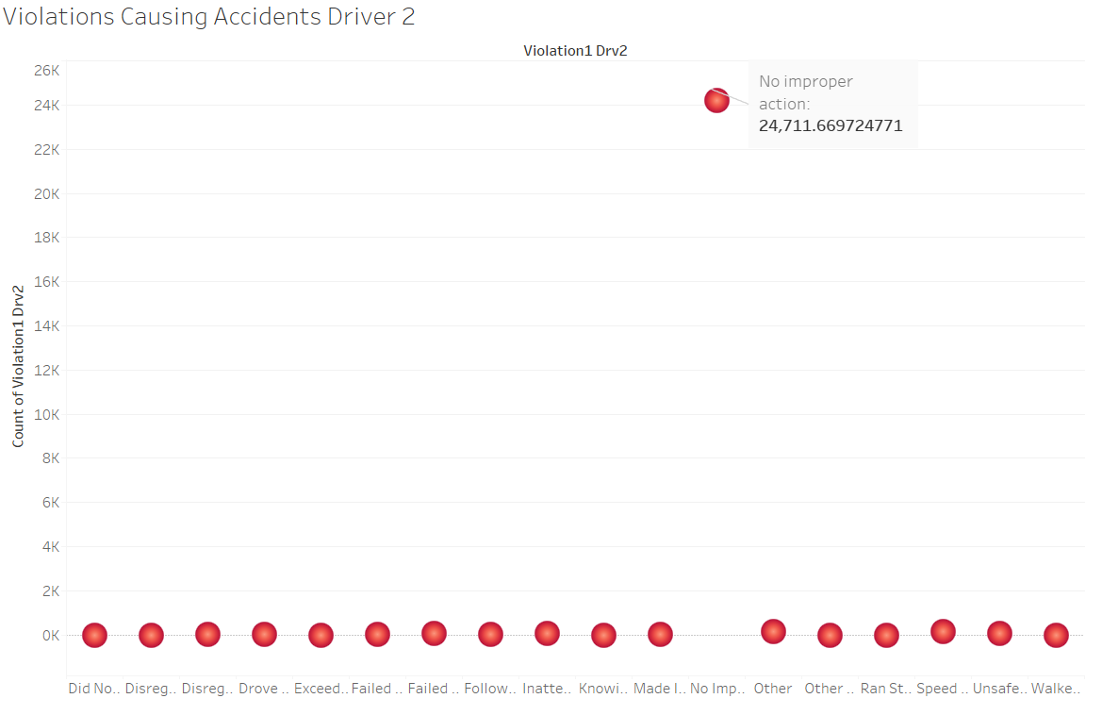
Violations that caused accidents - driver 2
The violations caused by driver

Slide 42
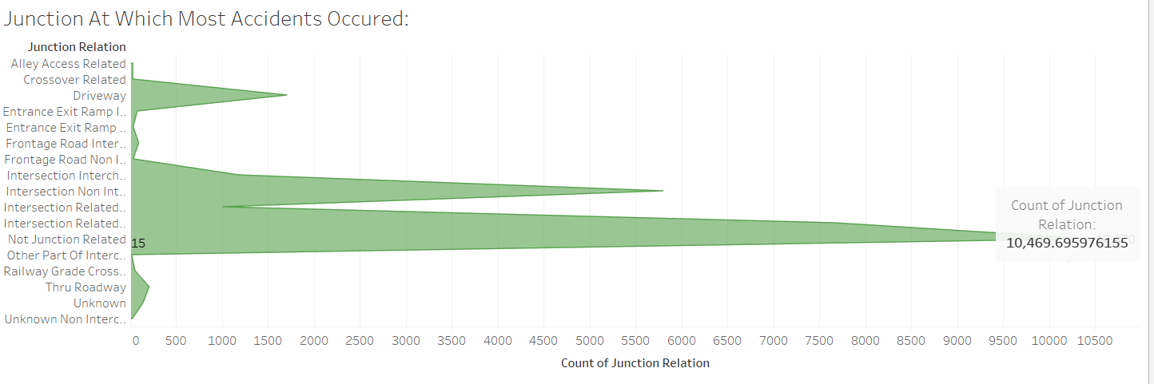
Junction where most of the accidents occurred
Here we can see that most of the accidents that occurred are not junction related.
But rather the accidents took place at the intersection and driveway

Slide 43
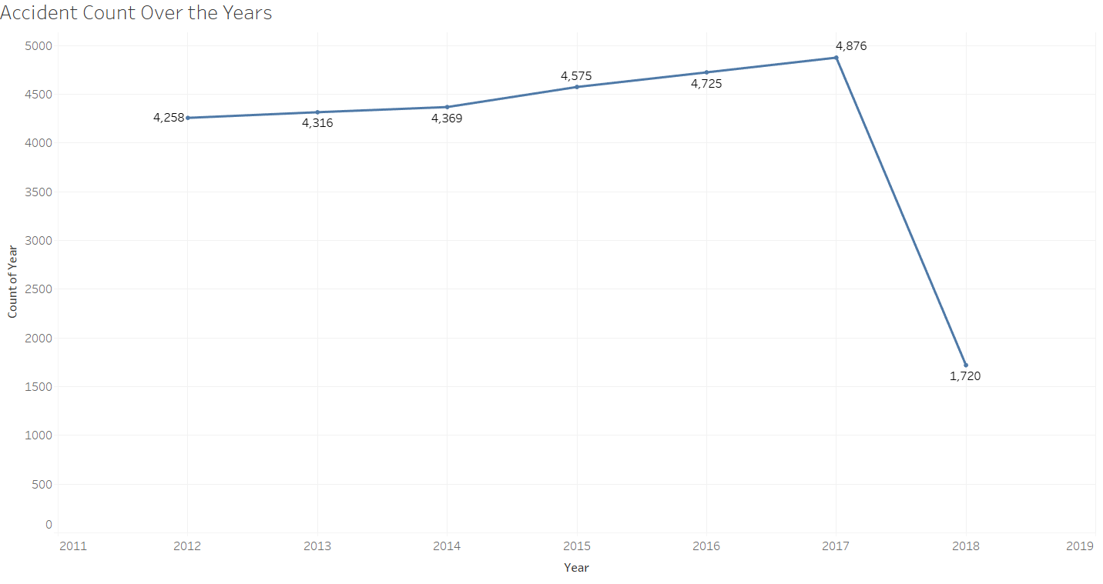
Number of accidents that took place over the years
Most of the accidents took place in the year 2017, with 4876 accidents.

Slide 44
References

Slide 45




https://seaborn.pydata.org/examples/index.html
https://community.tableau.com

